Slide 1
DeciQuest
Theme: A Cloud-based Metadata Extraction & Search Webpage.
Mansi Ganatra
Radhika Rao Annamraju

Slide 2
Features of DeciQuest
Deciquest allows the user to search for famous speeches delivered by historically significant figures.
Its features are:
1.Faceted Search
2. Key-word based search
3. Downloadable audio in mp3 format
4. PDF transcripts for speech is also available

Slide 3
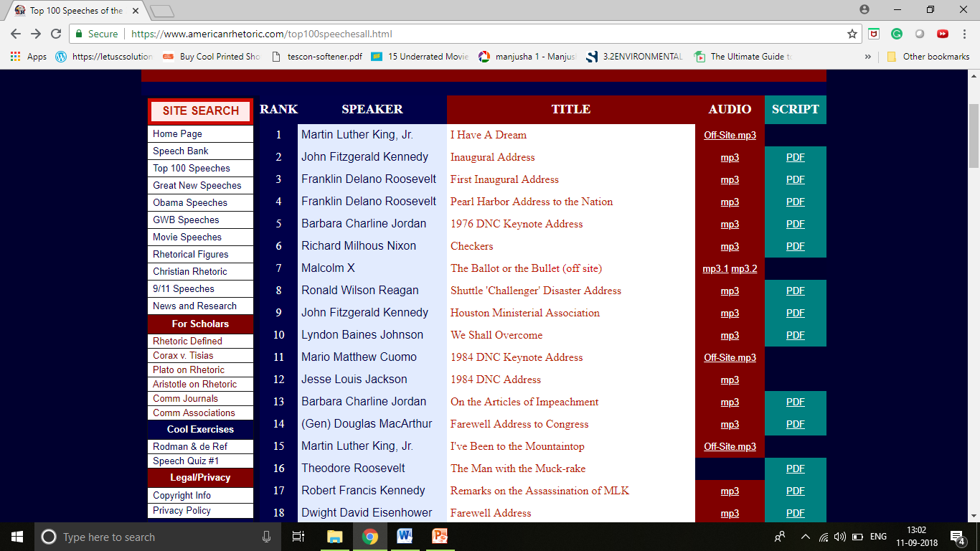
Data

Slide 4
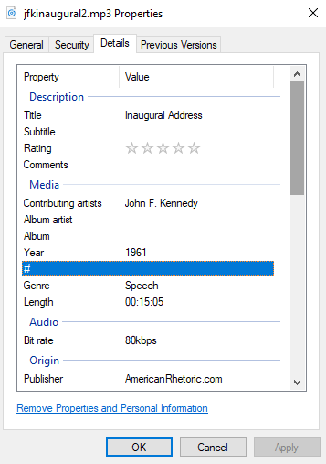
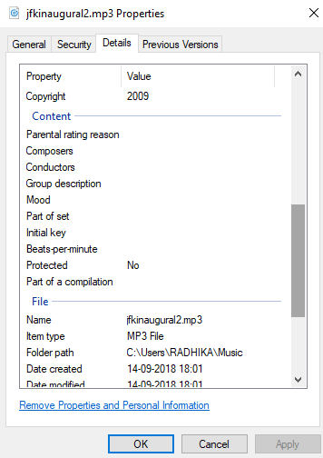
Metadata

Slide 5
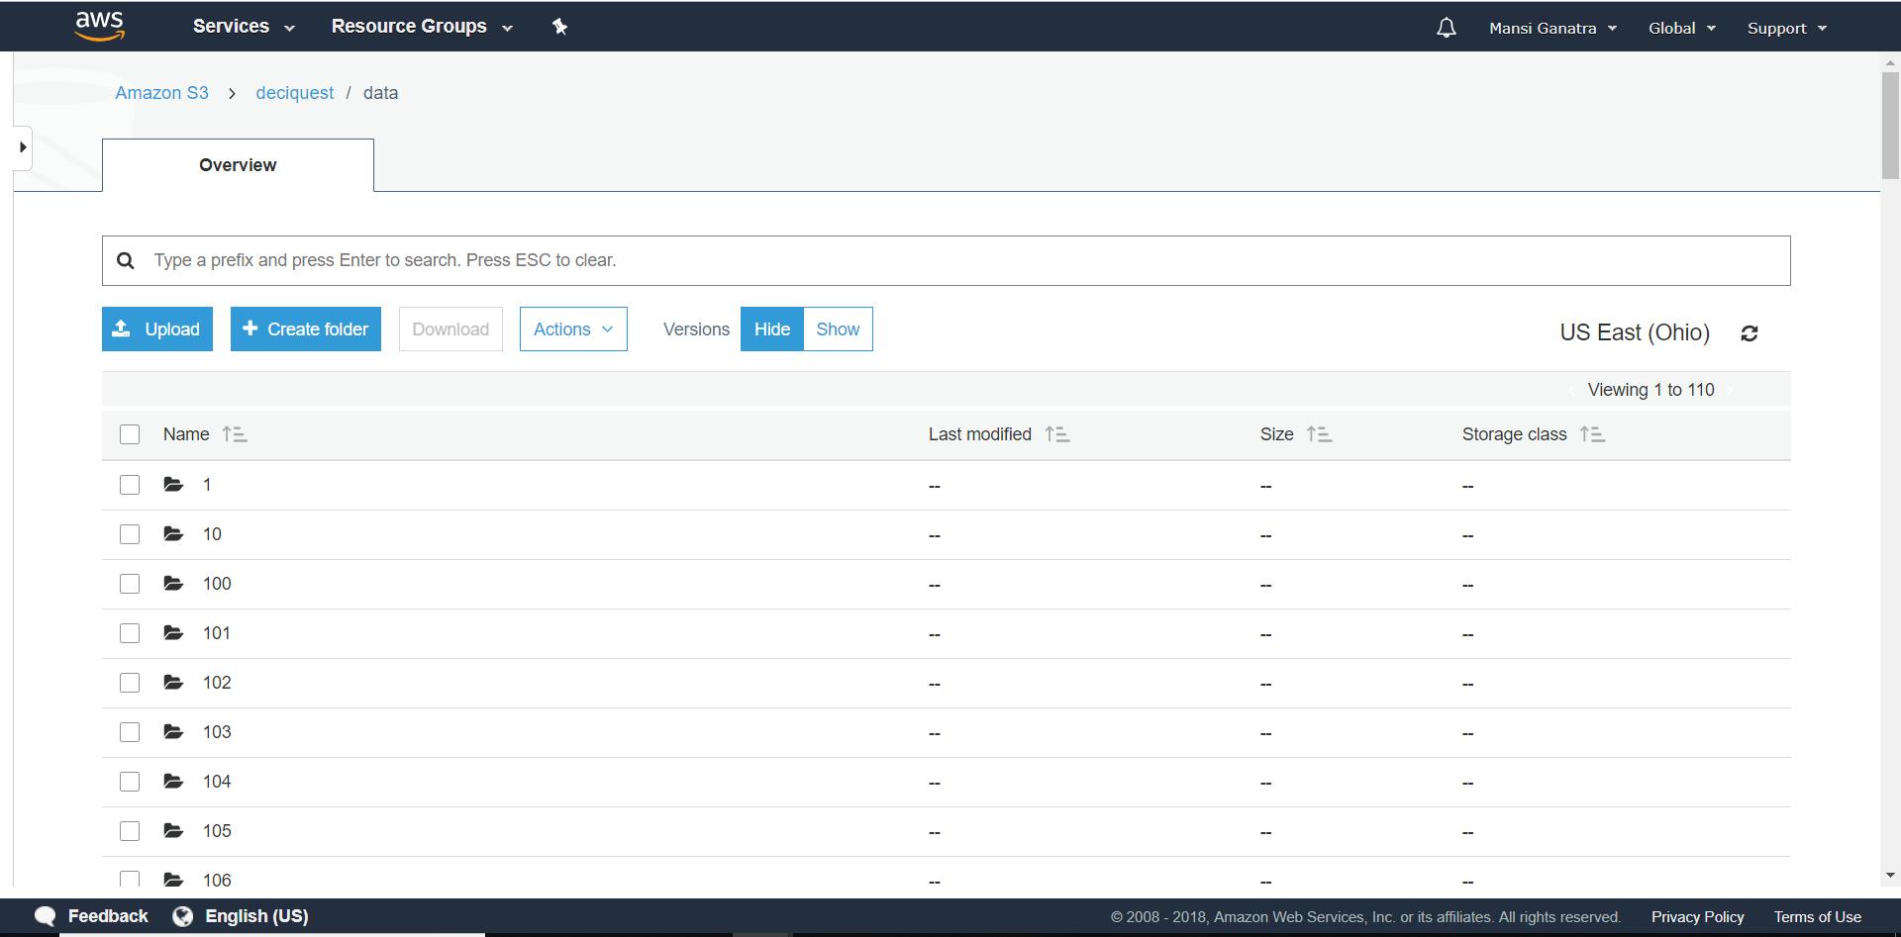
Data Storage on Amazon S3

Slide 6
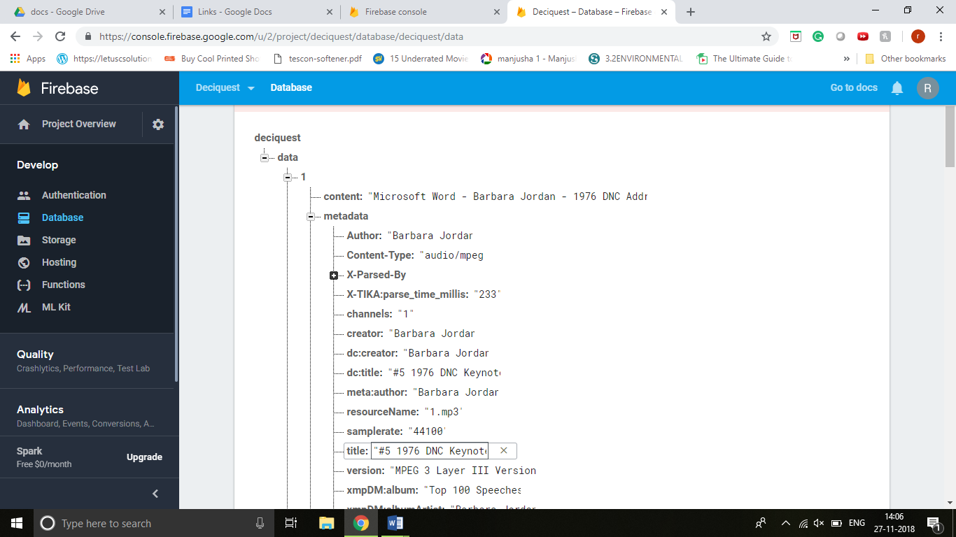
Metadata Storage on Firebase

Slide 7
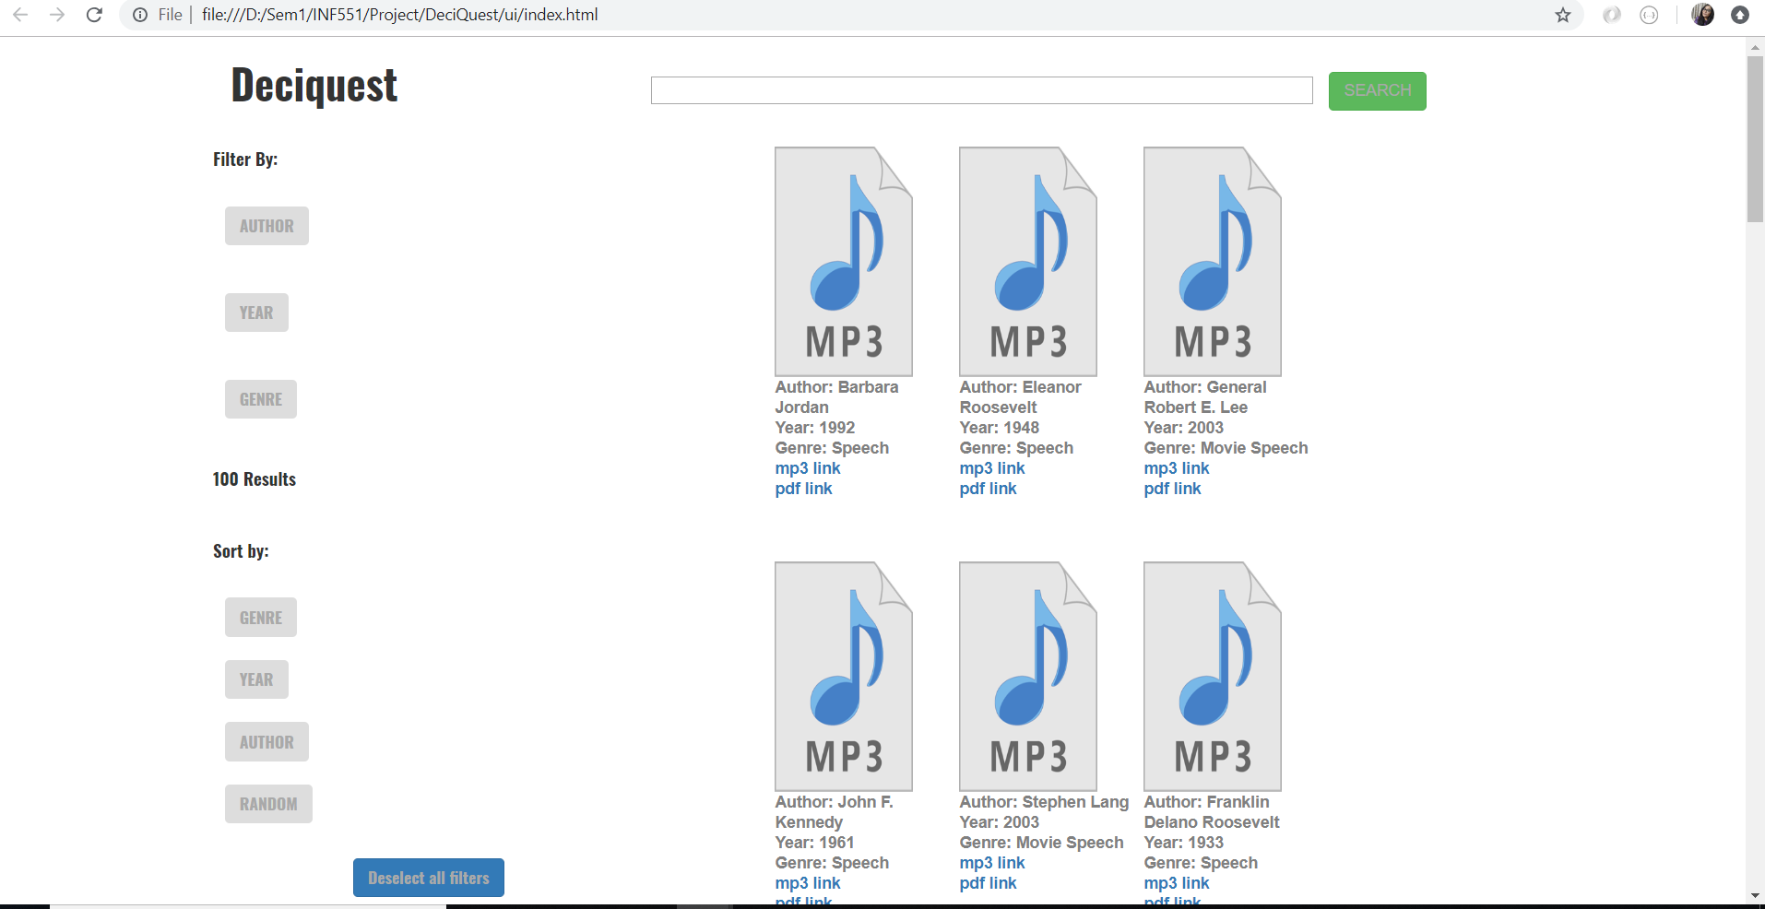
User Interface

